Slide 1
BM3D – Theory and Interpolation
Joe Driscoll

Slide 2
Interpolation/Upsampling with CBM3D

Slide 3
SR_CBM3D Algorithm

Slide 4
Experimental Procedure
Begin with a test image
Downsample and add noise
Upsample with bicubic and SR_BM3D
Compare performance
PSNR
SSIM
Visual appeal
Upsample test image and analyze visually
One example shown next

Slide 5
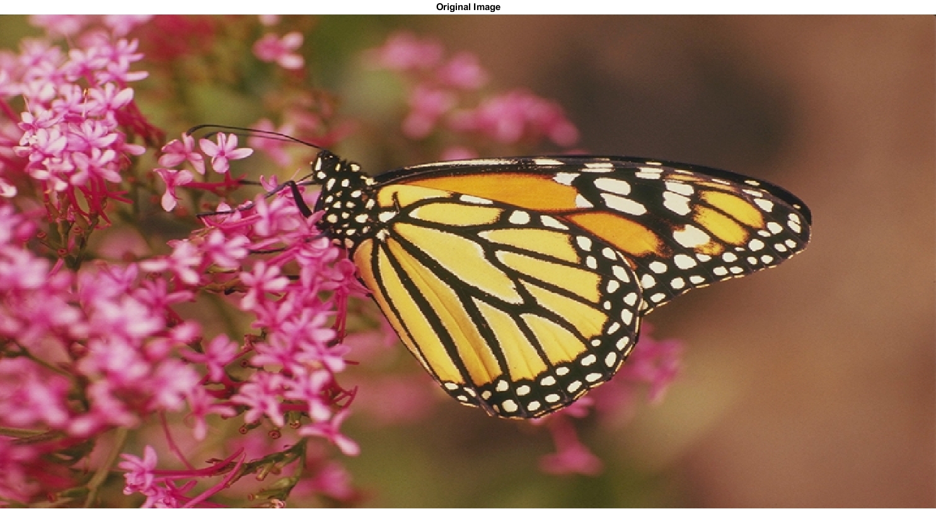
Monarch Test Image

Slide 6
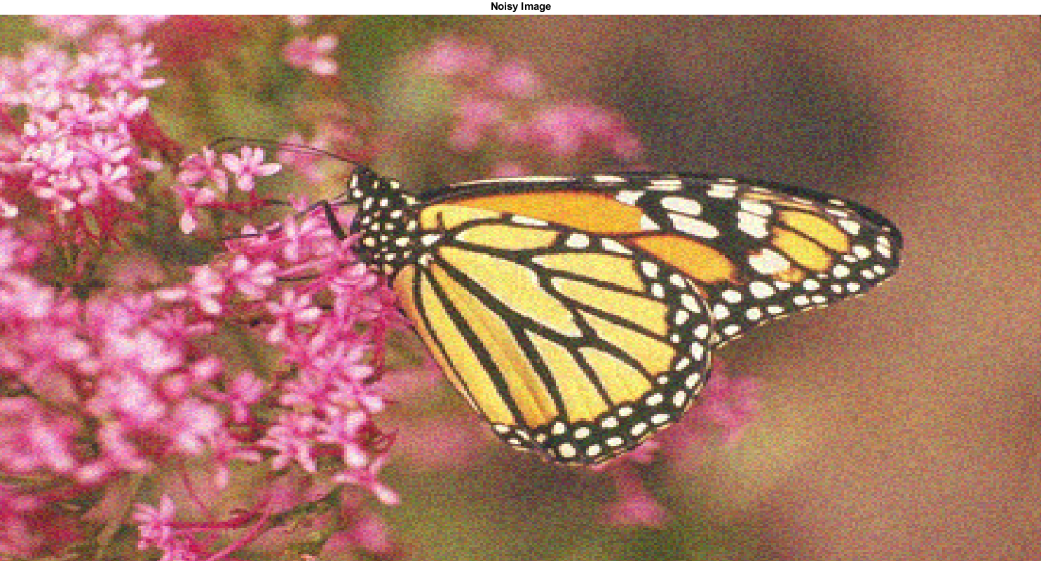
Noisy, Downsampled Image

Slide 7
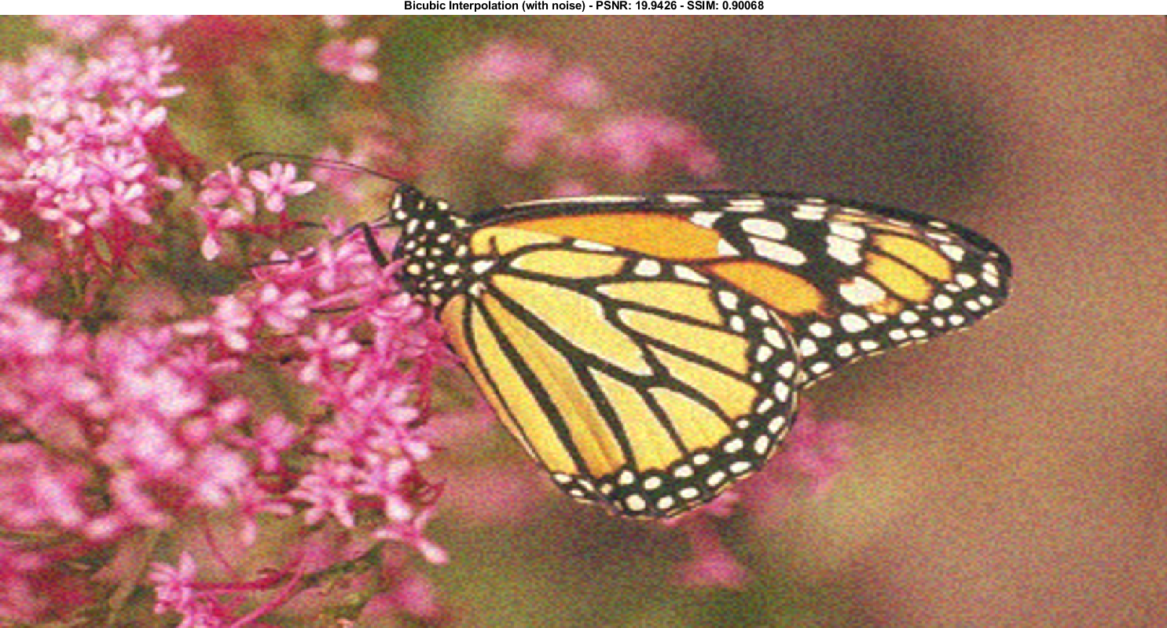
Bicubic Interpolation – PSNR: 19.94 dB – SSIM: 0.907

Slide 8

SR_CBM3D Interpolation – PSNR: 20.61 dB – SSIM: 0.955

Slide 9
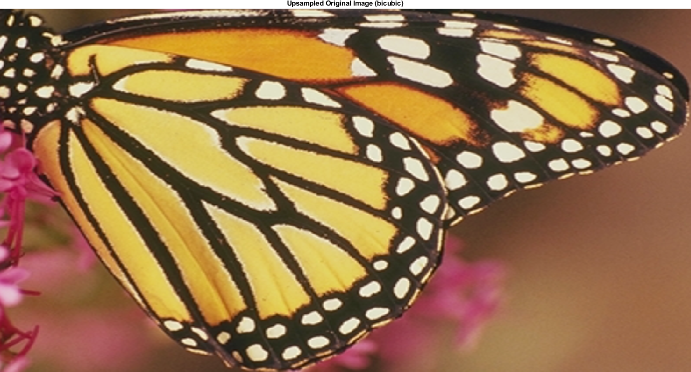
Bicubic Upsampling of Original (Zoomed)

Slide 10
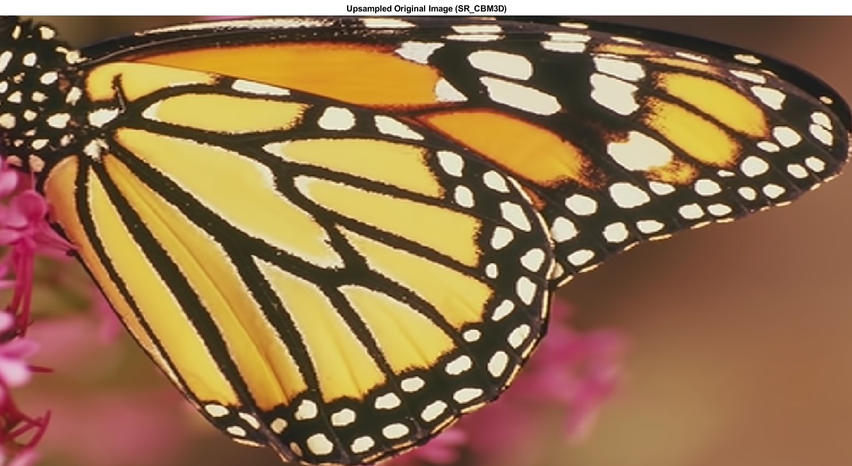
SR_CBM3D Upsampling of Original (Zoomed)

Slide 11
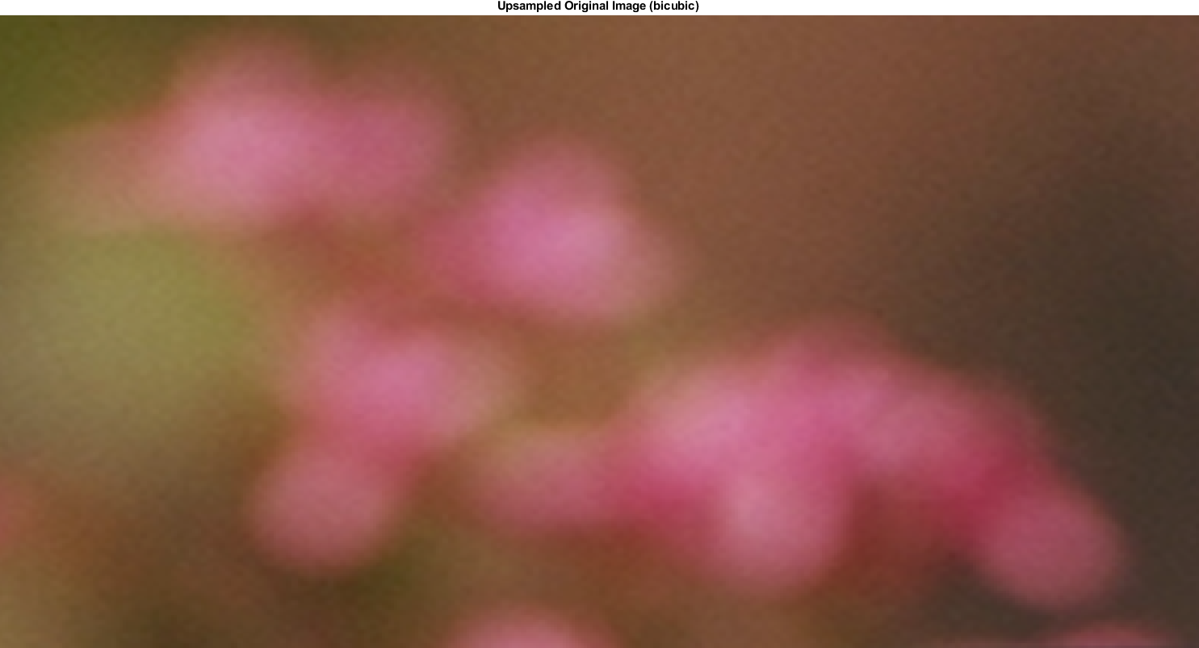
Bicubic Upsampling of Original (Zoomed)

Slide 12
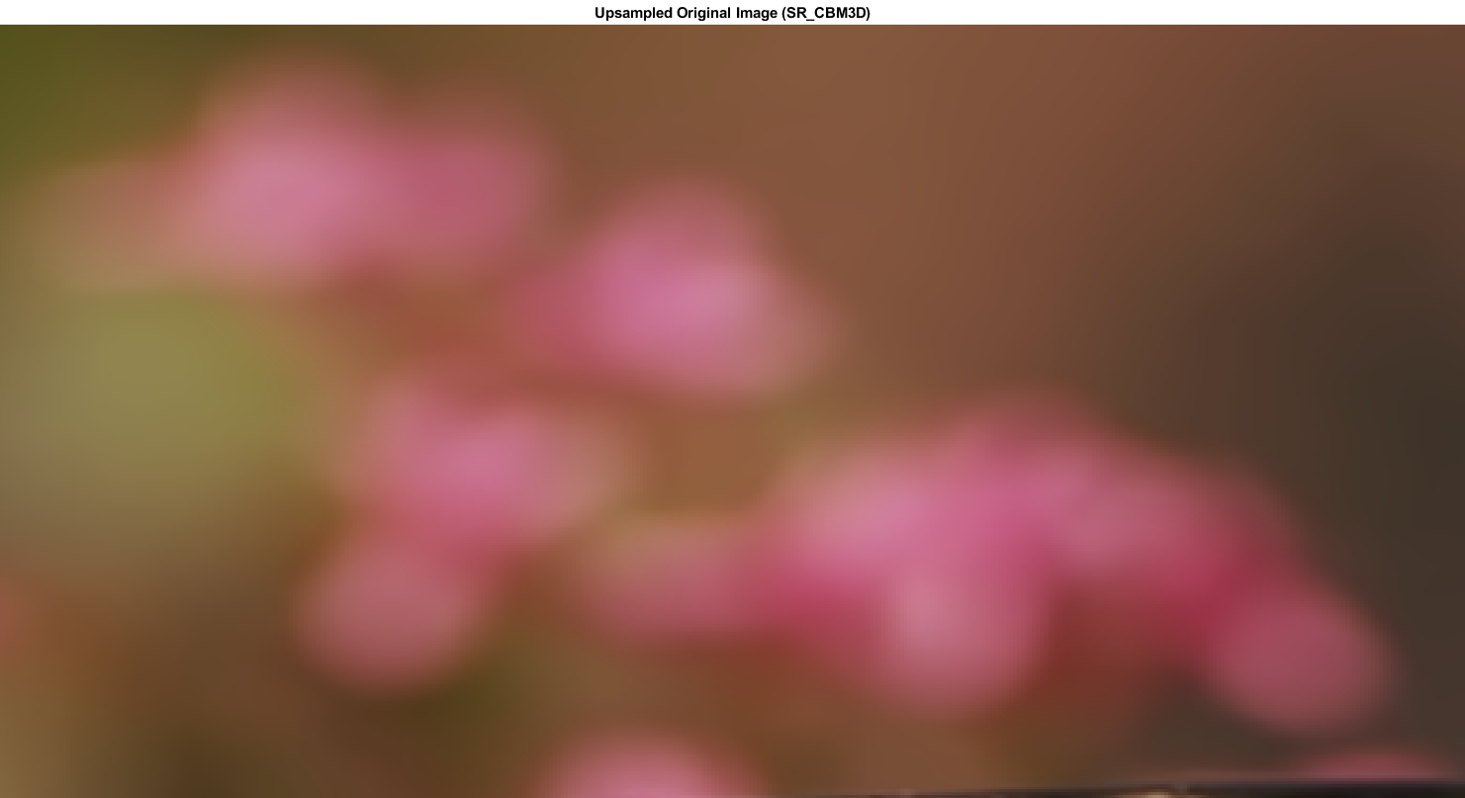
SR_CBM3D Upsampling of Original (Zoomed)

Slide 13
References
[1] Marc Lebrun.An analysis and implementation of thebm3d image denoising method.Image Processing On Line, 2012. https://github.com/jwd0023/ELEC7450/blob/master/papers/lebrunbm3danalysis.pdf.
[2] Dabov et al. Bm3d image denoising with shape-adaptive princi-pal component analysis. https://github.com/jwd0023/ELEC7450/blob/master/papers/dabovbm3dpca.pdf, 2009.
[3] Karen Egiazarian and Vladimir Katkovnik. Single image super-resolution via bm3d sparse coding. EUSIPCO, 2015. https://github.com/jwd0023/ELEC7450/blob/master/papers/egiazariansuperresolutionwithbm3d.pdf.
[4] Danielyanetal.Image upsampling via spatially adaptive block-matching filtering. EUSIPCO, 2008. https://github.com/jwd0023/ELEC7450/blob/master/papers/egiazarianimageupsampling.pdf.
[5] Dabov et al. Image denoising by sparse 3d transform-domain collaborative filtering. IEEE Transactions on Image Process-ing, 2007. https://github.com/jwd0023/ELEC7450/blob/master/papers/bm3d2007conferenceoriginal.pdf.

